Slide 1
Using printf
Text wird dunkler durch das -20
Usually, you’ll find it convenient to use variables or expressions as arguments to printf
What is this code doing?
printf("<span style='color:#%X%X%X'>Hello</span>", $r-20, $g-20, $b-20);
For instance, if you stored values for your colors in the three variables $r, $g, and $b, you could create a darker color in this way

Slide 2
Precision Setting
Not only can you specify a conversion type, but you can also set the precision of the displayed result.
For example, amounts of currency are usually displayed with only two digits of precision.
However, after a calculation, a value may have a greater precision than this, such as 123.42 / 12, which results in 10.285

Slide 3
Precision Setting
To ensure that such values are correctly stored internally, but displayed with only two digits of precision, you can insert the string ".2" between the % symbol and the conversion specifier:
printf("The result is: $%.2f", 123.42 / 12);
The output from this command is as follows:
The result is $10.29 (instead of 10.285000)

Slide 4
More examples with padding and precision:
<?php
echo "<pre>"; // Enables viewing of the spaces
// Pad to 15 spaces
printf("The result is $%15f\n", 123.42 / 12);
//The result is $ 10.285000
// Pad to 15 spaces, fill with zeros
printf("The result is $%015f\n", 123.42 / 12);
//The result is $00000010.285000
…
Notes:
In the first example is padding the number 10.285000 with “nothing” in front (even though you have a space)

Slide 5
Precision Setting
…
// Pad to 15 spaces, 2 decimal places precision
printf("The result is $%15.2f\n", 123.42 / 12);
//The result is $ 10.29
// Pad to 15 spaces, 2 decimal places precision, fill with zeros
printf("The result is $%015.2f\n", 123.42 / 12);
//The result is $000000000010.29
// Pad to 15 spaces, 2 decimal places precision, fill with # symbol
printf("The result is $%'#15.2f\n", 123.42 / 12);
//The result is $##########10.29
?>
Notes:
The quotation mark is there because the pound symbol is not a number

Slide 6
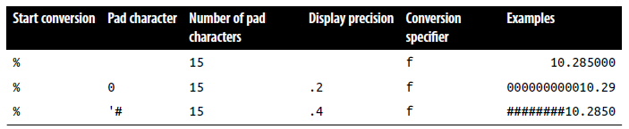
Precision Setting
The way it works is simple if you go from right to left. Notice that:
The rightmost character is the conversion specifier: in this case, f for floating point.
Just before the conversion specifier, if there is a period and a number together, then the precision of the output is specified as the value of the number.
Notes:
Note the single quotation before the # (pound)

Slide 7
Regardless of whether there’s a precision specifier, if there is a number, then that represents the number of characters to which the output should be padded.
In the previous example, this is 15 characters.
If the output is already equal to or greater than the padding length, then this argument is ignored.
The leftmost parameter allowed after the % symbol is a 0, which is ignored unless a padding value has been set, in which case the output is padded with zeros instead of spaces.
If a pad character other than zero or a space is required, you can use any one of your choices as long as you preface it with a single quotation mark, like this: ‘#

Slide 8
String Padding
You can also pad strings to required lengths (as you can with numbers), select different padding characters, and even choose between left and right justification.
<?php
echo "<pre>"; // Enables viewing of the spaces
$h = 'Rasmus’;
printf("[%s]\n", $h); // Standard string output [Rasmus]
printf("[%12s]\n", $h); // Right justify with spaces to width 12 [ Rasmus]
printf("[%-12s]\n", $h); // Left justify with spaces [Rasmus ]
printf("[%012s]\n", $h); // Zero padding [000000Rasmus]
printf("[%'#12s]\n\n", $h); // Use the custom padding character ‘#’ [######Rasmus]
Notes:
I’ve used the <pre> HTML tag to preserve all the spaces and the \n newline character after each of the lines to be displayed.

Slide 9
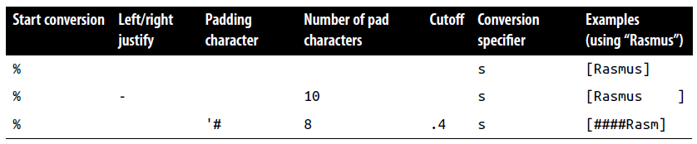
String Padding
$d = 'Rasmus Lerdorf’; // The original creator of PHP
printf("[%12.8s]\n", $d); // Right justify, cutoff of 8 characters [ Rasmus L]
printf("[%-12.12s]\n", $d); // Left justify, cutoff of 12 characters [Rasmus Lerdo]
printf("[%-'@12.10s]\n", $d); // Left justify, pad '@', cutoff 10 chars [Rasmus Ler@@]
?>
Notes:
When you are specifying a padding value, if a string is already of equal or greater length than that value, it will be ignored, unless a cutoff value is given that shortens the string back to less than the padding value.

Slide 10
Using sprintf
Often, you don’t want to output the result of a conversion but need it to use elsewhere in your code. This is where the sprintf function comes in.
With it, you can send the output to another variable rather than to the browser.
You might use it to make a conversion, as in the following example, which returns the hexadecimal string value for the RGB color group 65, 127, 245 in $hexstring:
$hexstring = sprintf("%X%X%X", 65, 127, 245);
Or you may wish to store output ready to display later on:
$out = sprintf("The result is: $%.2f", 123.42 / 12);
echo $out;

Slide 11
Date and Time Functions
To keep track of the date and time, PHP uses standard Unix timestamps, which are simply the number of seconds since the start of January 1, 1970.
To determine the current timestamp, you can use the time function:
echo time();
What is the output of this code?
echo time() + 7 * 24 * 60 * 60;
Because the value is stored as seconds, to obtain the timestamp for this time next week, you would use this code, which adds 7 days times 24 hours times 60 minutes times 60 seconds to the returned value
Notes:
Current time in seven days from now

Slide 12
Date and Time Functions
If you wish to create a timestamp for a given date, you can use the mktime function.
Its output is the timestamp 946684800 for the first second of the first minute of the first hour of the first day of the year 2000:
echo mktime(0, 0, 0, 1, 1, 2000);
The parameters to pass are, in order from left to right:
The number of the hour (0–23)
The number of the minute (0–59)
The number of seconds (0–59)
The number of the month (1–12)
The number of the day (1–31)
The year (1970–2038, or 1901–2038 with PHP 5.1.0+ on 32-bit signed systems)

Slide 13
Why am I limited to the years 1970-2038?
It’s because the original developers of Unix chose the start of the year 1970 as the base date that no programmer should need to go before!
Luckily, because (as of version 5.1.0) PHP supports systems using a signed 32-bit integer for the timestamp, dates from 1901 to 2038 are allowed on them.
However, that introduces a problem even worse than the original because the Unix designers also decided that nobody would be using Unix after about 70 years or so, and therefore believed they could get away with storing the timestamp as a 32-bit value—which will run out on January 19, 2038!
This will create what has come to be known as the Y2K38 bug (much like the millennium bug, which was caused by storing years as two-digit values, and which also had to be fixed).
PHP introduced the DateTime class in version 5.2 to overcome this issue, but it will work only on 64-bit architecture.

Slide 14
Date and Time Functions
To display the date, use the date function, which supports a plethora of formatting options, enabling you to display the date any way you wish. The format is as follows:
date($format, $timestamp);
The parameter $format should be a string containing formatting specifiers as detailed in the next slide Table, and $timestamp should be a Unix timestamp.
For the complete list of specifiers, please see http://php.net/manual/en/function.date.php

Slide 15
Date and Time Functions
The following command will output the current date and time in the format "Thursday September 26th, 2017 - 3:38pm":
echo date("l F jS, Y - g:ia", time());

Slide 16
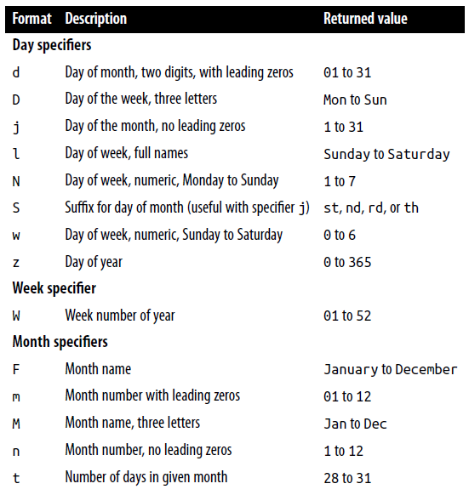
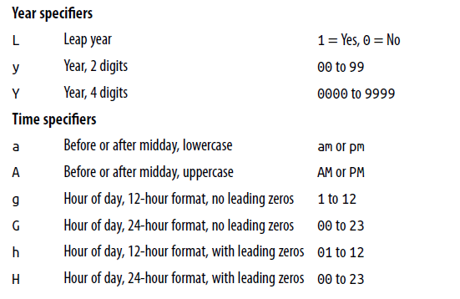

echo date("l F jS, Y - g:ia", time());
"Thursday September 26th, 2017 - 3:38pm"

Slide 17
Date Constants
There are a number of useful constants that you can use with the date command to return the date in specific formats.
For example, date(DATE_RSS) returns the current date and time in the valid format for an RSS feed. Some of the more commonly used constants are as follows:
DATE_ATOM
This is the format for Atom feeds.
The PHP format is "Y-m-d\TH:i:sP" and example output is
"2018-08-16T12:00:00+00:00"
DATE_COOKIE
This is the format for cookies set from a web server or JavaScript.
The PHP format is "l, d-M-y H:i:s T" and example output is
"Thursday, 16-Aug-18 12:00:00 UTC"

Slide 18
Date Constants
DATE_RSS
This is the format for RSS feeds.
The PHP format is "D, d M Y H:i:s O" and example output is
"Thu, 16 Aug 2018 12:00:00 UTC"
DATE_W3C
This is the format for the World Wide Web Consortium.
The PHP format is "Y-m-d \TH:i:sP" and example output is
"2018-08-16T12:00:00+00:00"
The complete list can be found at http://php.net/manual/en/class.datetime.php.

Slide 19
Using checkdate
You’ve seen how to display a valid date in a variety of formats.
But how can you check whether a user has submitted a valid date to your program?
The answer is to pass the month, day, and year to the checkdate function, which returns a value of TRUE if the date is valid, or FALSE if it is not.
For example, if February 30 of any year is input, it will always be an invalid date.
<?php
$month = 9; // September (only has 30 days)
$day = 31; // 31st
$year = 2018; // 2018
if (checkdate($month, $day, $year)) echo "Date is valid";
else echo "Date is invalid";
?>

Slide 20
File Handling
Powerful as it is, MySQL is not the only (or necessarily the best) way to store all data on a web server.
Sometimes it can be quicker and more convenient to directly access files on the hard disk.
Cases in which you might need to do this are modifying images such as uploaded user avatars, or log files that you wish to process.
First, though, a note about file naming: if you are writing code that may be used on various PHP installations, there is no way of knowing whether these systems are case-sensitive.
For example, Windows and Mac OS X filenames are not case-sensitive, but Linux and Unix ones are.
Therefore, you should always assume that the system is case-sensitive and stick to a convention such as all lowercase filenames.

Slide 21
Checking Whether a File Exists
To determine whether a file already exists, you can use the file_exists function, which returns either TRUE or FALSE, and is used like this:
if (file_exists("testfile.txt")) echo "File exists";

Slide 22
Creating a File
<?php // testfile.php
$fh = fopen("testfile.txt", 'w') or die("Failed to create file");
$text = <<<_END
Line 1
Line 2
Line 3
_END;
fwrite($fh, $text) or die("Could not write to file");
fclose($fh);
echo "File 'testfile.txt' written successfully";
Notes:
die(…) is equivalent to exit(…), they are the same thing

Slide 23
Creating a File
Try opening the file in a text or program editor—the contents will look like this:
Line 1
Line 2
Line 3

Slide 24
Creating a File
This simple example shows the sequence that all file handling takes:
Always start by opening the file. You do this through a call to fopen.
Then you can call other functions; here we write to the file (fwrite), but you can also read from an existing file (fread or fgets) and do other things.
Finish by closing the file (fclose). Although the program does this for you when it ends, you should clean up by closing the file when you’re finished.
Notes:
fgets reads a line -- i.e. it will stop at a newline.
fread reads raw data -- it will stop after a specified (or default) number of bytes, independently of any newline that might or might not be present.

Slide 25
Creating a File
Every open file requires a file resource so that PHP can access and manage it.
The preceding example sets the variable $fh (which I chose to stand for file handle) to the value returned by the fopen function.
Thereafter, each file-handling function that accesses the opened file, such as fwrite or fclose, must be passed $fh as a parameter to identify the file being accessed.
Don’t worry about the content of the $fh variable; it’s a number PHP uses to refer to internal information about the file—you just pass the variable to other functions
Upon failure, FALSE will be returned by fopen. The previous example shows a simple way to capture and respond to the failure: it calls the die function to end the program and give the user an error message.

Slide 26
Creating a File
A web application would never abort in this crude way!
You would create a web page with an error message instead, but this is fine for our testing purposes.
$fh = fopen("testfile.txt", 'w') or die("Failed to create file");
Notice the second parameter to the fopen call.
It is simply the character w, which tells the function to open the file for writing.
The function creates the file if it doesn’t already exist.
Be careful when playing around with these functions: if the file already exists, the w mode parameter causes the fopen call to delete the old contents (even if you don’t write anything new!).

Slide 27
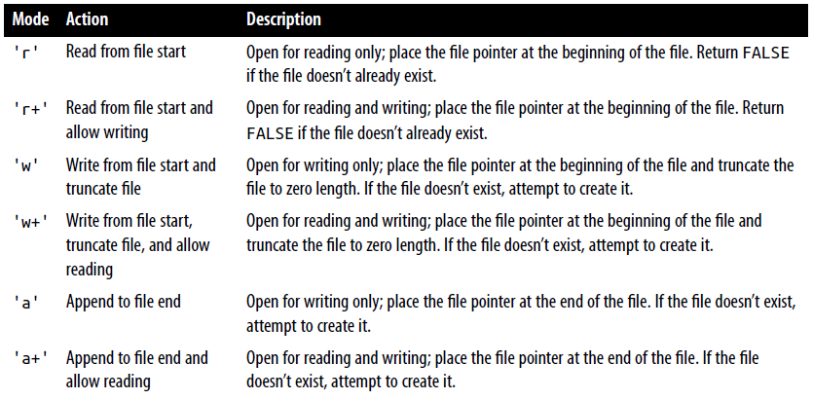

Slide 28
Reading from Files
The easiest way to read from a text file is to grab a whole line through fgets (think of the final s as standing for string)
<?php
$fh = fopen("testfile.txt", 'r') or
die("File does not exist or you lack permission to open it");
$line = fgets($fh);
fclose($fh);
echo $line;
?>

Slide 29
Reading from Files
Or you can retrieve multiple lines or portions of lines through the fread function
<?php
$fh = fopen("testfile.txt", 'r') or
die("File does not exist or you lack permission to open it");
$text = fread($fh, 3); // I’ve requested three characters in the fread call
fclose($fh);
echo $text;
?>
The fread function is commonly used with binary data.
But if you use it on text data that spans more than one line, remember to count newline characters!

Slide 30
Copying Files
Let’s try out the PHP copy function to create a clone of testfile.txt.
<?php // copyfile.php
copy('testfile.txt', 'testfile2.txt') or die("Could not copy file");
echo "File successfully copied to 'testfile2.txt'";
?>
If you don’t want your programs to exit on a failed copy attempt, you could try this alternate syntax
<?php // copyfile2.php
if (!copy('testfile.txt', 'testfile2.txt')) echo "Could not copy file";
else echo "File successfully copied to 'testfile2.txt'";
?>

Slide 31
Moving a File
To move a file, rename it with the rename function
<?php // movefile.php
if (!rename('testfile2.txt', 'testfile2.new’))
echo "Could not rename file";
else echo "File successfully renamed to 'testfile2.new’”;
?>
You can use the rename function on directories, too.
To avoid any warning messages, if the original file doesn’t exist, you can call the file_exists function first to check.

Slide 32
Deleting a File
Deleting a file is just a matter of using the unlink function to remove it from the file system
<?php // deletefile.php
if (!unlink('testfile2.new')) echo "Could not delete file";
else echo "File 'testfile2.new' successfully deleted";
?>

Slide 33
Deleting a File
Check which file you are going to delete!
Whenever you access files on your hard disk directly, you must also always ensure that it is impossible for your file system to be compromised.
For example, if you are deleting a file based on user input, you must make absolutely certain it is a file that can be safely deleted and that the user is allowed to delete it.

Slide 35
Updating Files
You can use one of the append write modes, or you can simply open a file for reading and writing with one of the other modes that supports writing, and move the file pointer to the correct place within the file that you wish to write to or read from.
The file pointer is the position within a file at which the next file access will take place, whether it’s a read or a write.
It is not the same as the file handle (as stored in the variable $fh), which contains details about the file being accessed.

Slide 36
Updating Files
This program opens testfile.txt for both reading and writing by setting the mode with 'r+', which puts the file pointer right at the start.
It then uses the fgets function to read in a single line from the file (up to the first line feed).
<?php // update.php
$fh = fopen("testfile.txt", 'r+') or die("Failed to open file");
$text = fgets($fh);
fseek($fh, 0, SEEK_END);
fwrite($fh, "$text") or die("Could not write to file");
fclose($fh);
echo "File 'testfile.txt' successfully updated";
?>

Slide 37
Updating Files
<?php // update.php
$fh = fopen("testfile.txt", 'r+') or die("Failed to open file");
$text = fgets($fh);
fseek($fh, 0, SEEK_END);
fwrite($fh, "$text") or die("Could not write to file");
fclose($fh);
echo "File 'testfile.txt' successfully updated";
?>
After that, the fseek function is called to move the file pointer right to the file end, at which point the line of text that was extracted from the start of the file (stored in $text) is then appended to file’s end and the file is closed.

Slide 38
Updating Files
<?php // update.php
$fh = fopen("testfile.txt", 'r+') or die("Failed to open file");
$text = fgets($fh);
fseek($fh, 0, SEEK_END);
fwrite($fh, "$text") or die("Could not write to file");
fclose($fh);
echo "File 'testfile.txt' successfully updated";
?>
In addition to the $fh file handle, the fseek function was passed two other parameters, 0 and SEEK_END.
SEEK_END tells the function to move the file pointer to the end of the file, and 0 tells it how many positions it should then be moved backward from that point.
Notes:
In this case, a value of 0 is used, because the pointer is required to remain at the file’s end.
To move to a position before the end-of-file, you need to pass a negative value in offset
fseek($fp, 0); (or rewind($fp);) to point the beginning of the file
NOTE: If you have opened the file in append (a or a+) mode, any data you write to the file will always be appended, regardless of the file position, and the result of calling fseek() will be undefined.

Slide 39
Updating Files
There are two other seek options available to the fseek function:
The SEEK_SET option tells the function to set the file pointer to the exact position given by the preceding parameter.
Thus, the following example moves the file pointer to position 18:
fseek($fh, 18, SEEK_SET);
The SEEK_CUR sets the file pointer to the current position plus the value of the given offset.
Therefore, if the file pointer is currently at position 18, the following call will move it to position 23:
fseek($fh, 5, SEEK_CUR);
Notes:
The new position is measured in bytes from the beginning of the file.

Slide 40
Updating Files
Although this is not recommended unless you have very specific reasons for it, it is even possible to use text files as simple flat file databases.
Your program can then use fseek to move back and forth within such a file to retrieve, update, and add new records.
You can also delete records by overwriting them with zero characters, and so on.
Notes:
files but with fixed line lengths, obviously

Slide 41

Locking Files for Multiple Accesses
Web programs are often called by many users at the same time.
If more than one person tries to write to a file simultaneously, it can become corrupted
And if one person writes to it while another is reading from it, the file is all right, but the person reading it can get odd results
To handle simultaneous users, you must use the file-locking flock function. This function queues up all other requests to access a file until your program releases the lock.

Slide 42
Locking Files for Multiple Accesses
So, whenever your programs use write access on files that may be accessed concurrently by multiple users, you should also add file locking to them
<?php
$fh = fopen("testfile.txt", 'r+') or die("Failed to open file");
$text = fgets($fh);
if (flock($fh, LOCK_EX))
{
fseek($fh, 0, SEEK_END);
fwrite($fh, "$text") or die("Could not write to file");
fflush($fp);
flock($fh, LOCK_UN);
}
fclose($fh);
echo "File 'testfile.txt' successfully updated";
?>
Notes:
LOCK_EX is for Exclusive Lock (there is also LOCK_SH, Shared Lock)

Slide 43
Locking Files for Multiple Accesses
There is a trick to file locking to preserve the best possible response time for your website visitors:
Perform the lock directly before a change you make to a file, and then unlock it immediately afterward.
Having a file locked for any longer than this will slow down your application unnecessarily.
This is why the calls to flock in the previous example are directly before and after the fwrite call.
Notes:
The fseek is part of the LOCK because the position of the pointer could point to the wrong position (due to modifications done by other users)
The file pointer is not shared with the other users though.

Slide 44
Locking Files for Multiple Accesses
The first call to flock sets an exclusive file lock on the file referred to by $fh using the LOCK_EX parameter:
flock($fh, LOCK_EX);
From this point onward, no other processes can write to/read from the file until you release the lock by using the LOCK_UN parameter, like this:
flock($fh, LOCK_UN);
Notes:
On versions of PHP before 5.3.2, the lock is released also by fclose() (which is also called automatically when script finished).

Slide 45
Locking Files for Multiple Accesses
As soon as the lock is released, other processes are again allowed access to the file.
This is one reason why you should re-seek to the point you wish to access in a file each time you need to read or write data, because another process could have changed the file since the last access.
However, did you notice that the call to request an exclusive lock is nested as part of an if statement?
This is because flock is not supported on all systems; thus, it is wise to check whether you successfully secured a lock, just in case one could not be obtained.

Slide 46
Locking Files for Multiple Accesses
Something else you must consider is that flock is what is known as an advisory lock
This means that it locks out only other processes that call the function
If you have any code that goes right in and modifies files without implementing flock file locking, it will always override the locking and could wreak havoc on your files.
By the way, implementing file locking and then accidentally leaving it out in one section of code can lead to an extremely hard-to-locate bug.

Slide 47
Locking Files for Multiple Accesses
flock will not work on NFS and many other networked file systems
Also, doesn’t work in multithreaded server
When using a multithreaded server like ISAPI, you may not be able to rely on flock to protect files against other PHP scripts running in parallel threads of the same server instance.
Additionally, flock is not supported on any system using the old FAT file system, such as older versions of Windows.

Slide 48
Reading an Entire File
A handy function for reading in an entire file without having to use file handles is file_get_contents
<?php
echo "<pre>"; // Enables display of line feeds
echo file_get_contents("testfile.txt");
echo "</pre>"; // Terminates pre tag
?>

Slide 49
But the function is actually a lot more useful than that, because you can also use it to fetch a file from a server across the Internet, and then displays it as if the user had surfed to the page itself.
<?php
echo file_get_contents("http://www.yahoo.com");
?>

Slide 50

Uploading Files
Image uploader upload.php
<?php // upload.php
echo <<<_END
<html><head><title>PHP Form Upload</title></head><body>
<form method='post' action='upload.php' enctype='multipart/form-data’>
Select File: <input type='file' name='filename' size='10’>
<input type='submit' value='Upload’>
</form>
_END;
if ($_FILES)
{
$name = $_FILES['filename']['name’];
move_uploaded_file($_FILES['filename']['tmp_name'], $name);
echo "Uploaded image '$name'<br><img src='$name'>";
}
echo "</body></html>";
?>
Notes:
When you run it, you’ll see a form in your browser that lets you upload a file of your choice.

Slide 51
Uploading Files
NOTE!
The associative array $_FILES cannot be empty if you use two separate files (.html and .php).
In fact, as soon as you click on Upload, $_FILES will contain an information that tells "I'm empty", but this information makes it not empty as for testing it with a direct if statement.
It's better to keep the files together, but in case you should change:
if($_FILES)
with
if($_FILES[‘filename']['size'][0] === 0)
Image uploader upload.php
<?php // upload.php
echo <<<_END
<html><head><title>PHP Form Upload</title></head><body>
<form method='post' action='upload.php' enctype='multipart/form-data’>
Select File: <input type='file' name='filename' size='10’>
<input type='submit' value='Upload’>
</form>
_END;
if ($_FILES)
{
$name = $_FILES['filename']['name’];
move_uploaded_file($_FILES['filename']['tmp_name'], $name);
echo "Uploaded image '$name'<br><img src='$name'>";
}
echo "</body></html>";
?>
Notes:
When you run it, you’ll see a form in your browser that lets you upload a file of your choice.

Slide 52
Uploading Files
The first line of the multiline echo statement starts an HTML document, displays the title, and then starts the document’s body.
Image uploader upload.php
<?php // upload.php
echo <<<_END
<html><head><title>PHP Form Upload</title></head><body>
<form method='post' action='upload.php' enctype='multipart/form-data’>
Select File: <input type='file' name='fime' size='10’>
<input type='submit' value='Upload’>
</form>
_END;
if ($_FILES)
{
$name = $_FILES['fime']['name’];
move_uploaded_file($_FILES['filename']['tmp_name'], $name);
echo "Uploaded image '$name'<br><img src='$name'>";
}
echo "</body></html>";
?>
Notes:
When you run it, you’ll see a form in your browser that lets you upload a file of your choice.

Slide 53
Uploading Files
Next we come to the form that selects the Post method of form submission, sets the target for posted data to the program upload.php (the program itself), and tells the web browser that the data posted should be encoded via the content MIME type of multipart/form-data
Image uploader upload.php
<?php // upload.php
echo <<<_END
<html><head><title>PHP Form Upload</title></head><body>
<form method='post' action='upload.php' enctype='multipart/form-data’>
Select File: <input type='file' name='filename' size='10’>
<input type='submit' value='Upload’>
</form>
_END;
if ($_FILES)
{
$name = $_FILES['filename']['name’];
move_uploaded_file($_FILES['filename']['tmp_name'], $name);
echo "Uploaded image '$name'<br><img src='$name'>";
}
echo "</body></html>";
?>
Notes:
All you need to do to upload a file from a form is choose a special type of encoding called multipart/form-data, and your browser will handle the rest.

Slide 54
Uploading Files
Image uploader upload.php
<?php // upload.php
echo <<<_END
<html><head><title>PHP Form Upload</title></head><body>
<form method='post' action='upload.php' enctype='multipart/form-data’>
Select File: <input type='file' name='filename' size='10’>
<input type='submit' value='Upload’>
</form>
_END;
With the form set up, the next lines display the prompt Select File: and then request two inputs.
The first request is for a file; it uses an input type of file, a name of filename, and an input field with a width of 10 characters.
The second requested input is just a Submit button that is given the label Upload (which replaces the default button text of Submit Query).
And then the form is closed.
Notes:
When you run it, you’ll see a form in your browser that lets you upload a file of your choice.

Slide 55
Uploading Files
Image uploader upload.php
<?php // upload.php
echo <<<_END
<html><head><title>PHP Form Upload</title></head><body>
<form method='post' action='upload.php' enctype='multipart/form-data’>
Select File: <input type='file' name='filename' size='10’>
<input type='submit' value='Upload’>
</form>
_END;
This short program shows a common technique in web programming in which a single program is called twice:
Once when the user first visits a page
And again when the user presses the Submit button.
Notes:
When you run it, you’ll see a form in your browser that lets you upload a file of your choice.

Slide 56
Uploading Files
The PHP code to receive the uploaded data is fairly simple, because all uploaded files are placed into the associative system array $_FILES
Therefore, a quick check to see whether $_FILES contains anything is sufficient to determine whether the user has uploaded a file.
This is done with the statement if ($_FILES)
if ($_FILES)
{
$name = $_FILES['filename']['name’];
move_uploaded_file($_FILES['filename']['tmp_name'], $name);
echo "Uploaded image '$name'<br><img src='$name'>";
}
echo "</body></html>";
?>

Slide 57
Uploading Files
The first time the user visits the page, before uploading a file, $_FILES is empty, so the program skips this block of code.
When the user uploads a file, the program runs again and discovers an element in the $_FILES array.
if ($_FILES)
{
$name = $_FILES['filename']['name’];
move_uploaded_file($_FILES['filename']['tmp_name'], $name);
echo "Uploaded image '$name'<br><img src='$name'>";
}
echo "</body></html>";
?>

Slide 58
Uploading Files
Once the program realizes that a file was uploaded, the actual name, as read from the uploading computer, is retrieved and placed into the variable $name.
if ($_FILES)
{
$name = $_FILES['filename']['name’];
move_uploaded_file($_FILES['filename']['tmp_name'], $name);
echo "Uploaded image '$name'<br><img src='$name'>";
}
echo "</body></html>";
?>

Slide 59
Uploading Files
Now all that’s necessary is to move the file from the temporary location in which PHP stored the uploaded file to a more permanent one.
We do this using the move_uploaded_file function, passing it the original name of the file, with which it is saved to the current directory.
Finally, the uploaded image is displayed within an IMG tag
if ($_FILES)
{
$name = $_FILES['filename']['name’];
move_uploaded_file($_FILES['filename']['tmp_name'], $name);
echo "Uploaded image '$name'<br><img src='$name'>";
}
echo "</body></html>";
?>

Slide 60
Uploading Files
If you run this program and receive warning messages such as Permission denied for the move_uploaded_file function call…
…then you may not have the correct permissions set for the folder in which the program is running.

Slide 61
Using $_FILES
Five things are stored in the $_FILES array when a file is uploaded, as shown below:
Array element Contents
$_FILES['file']['name’] The name of the uploaded file (e.g., smiley.jpg)
$_FILES['file']['type’] The content type of the file (e.g., image/jpeg)
$_FILES['file']['size’] The file’s size in bytes
$_FILES['file']['tmp_name’] The name of the temporary file stored on the server
$_FILES['file']['error’] The error code resulting from the file upload
Content types used to be known as MIME (Multipurpose Internet Mail Extension) types, but because their use later expanded to the whole Internet, now they are often called Internet media types

Slide 62
Using $_FILES
Below some of the more frequently used types that turn up in $_FILES['file']['type’].
Some common Internet media content types
application/pdf image/gif multipart/form-data text/xml
application/zip image/jpeg text/css video/mpeg
audio/mpeg image/png text/html video/mp4
audio/x-wav image/tiff text/plain video/quicktime

Slide 63
Validation
I hope it now goes without saying (although I’ll do so anyway) that form data validation is of the utmost importance, due to the possibility of users attempting to hack into your server.
In addition to maliciously formed input data, some of the things you also have to check are whether a file was actually received and, if so, whether the right type of data was sent.

Slide 64
<?php // upload2.php
echo <<<_END
<html><head><title>PHP Form Upload</title></head><body>
<form method='post' action='upload2.php' enctype='multipart/form-data’>
Select a JPG, GIF, PNG or TIF File:
<input type='file' name='filename' size='10’>
<input type='submit' value='Upload'></form>
_END;
…
Notes:
Taking all these things into account, this is a more secure rewrite of upload.php

Slide 65
if ($_FILES) {
$name = $_FILES['filename']['name’];
switch($_FILES['filename']['type’]) {
case 'image/jpeg’ : $ext = 'jpg'; break;
case 'image/gif’ : $ext = 'gif'; break;
case 'image/png’ : $ext = 'png'; break;
case 'image/tiff’ : $ext = 'tif'; break;
default : $ext = ''; break;
}
if ($ext) {
$n = "image.$ext";
move_uploaded_file($_FILES['filename']['tmp_name'], $n);
echo "Uploaded image '$name' as '$n':<br>";
echo "<img src='$n'>";
}
else echo "'$name' is not an accepted image file";
}
else echo "No image has been uploaded";
echo "</body></html>";
?>
If $ext is empty, this is false
Notes:
The non-HTML section of code has been expanded from the half-dozen lines to more than 20 lines, starting at if ($_FILES)

Slide 66
Validation
Don’t worry about having to delete the temporary file that PHP creates during the upload process
The file will be automatically removed when the program exits.
When you write your own file-uploading routines, I strongly advise you to use a similar approach and have pre-chosen names and locations for uploaded files.

Slide 67
Validation
That way, no attempts to add pathnames and other malicious data to the variables you use can get through.
You can use prefixes or personalized directories for different users
If this means that more than one user could end up having a file uploaded with the same name, you could prefix such files with their user’s name, or save them to individually created folders for each user.

Slide 68
Validation
But if you must use a supplied filename, you should sanitize it by allowing only alphanumeric characters and the period, which you can do with the following command, using a regular expression to perform a search and replace on $name:
$name = preg_replace("/[^A-Za-z0-9.]/", "", $name);
This leaves only the characters A–Z, a–z, 0–9, and periods in the string $name, and strips out everything else.

Slide 69
Validation
Even better, to ensure that your program will work on all systems, regardless of whether they are case-sensitive or case-insensitive, you should probably use the following command instead, which changes all uppercase characters to lowercase at the same time:
$name = strtolower(ereg_replace("[^A-Za-z0-9.]", "", $name));
Notes:
Sometimes you may encounter the media type of image/pjpeg, which indicates a progressive JPEG, but you can safely add this to your code as an alias of image/jpeg, like this:
case 'image/pjpeg':
case 'image/jpeg': $ext = 'jpg'; break;

Slide 70
System Calls
Sometimes PHP will not have the function you need to perform a certain action, but the operating system it is running on may.
In such cases, you can use the exec system call to do the job.

Slide 71
//Executing a system command
<?php
$cmd = "dir"; // Windows
// $cmd = "ls"; // Linux, Unix & Mac
exec(escapeshellcmd($cmd), $output, $status);
if ($status) echo "Exec command failed";
else
{
echo "<pre>";
foreach($output as $line) echo htmlspecialchars("$line\n");
echo "</pre>";
}
?>
The htmlspecialchars function is called to turn any special characters returned by the system into ones that HTML can understand and properly display, neatening the output.
On Linux, Unix, or Mac OS X, comment out or remove the first line and uncomment the second to use the ls system command.

Slide 72
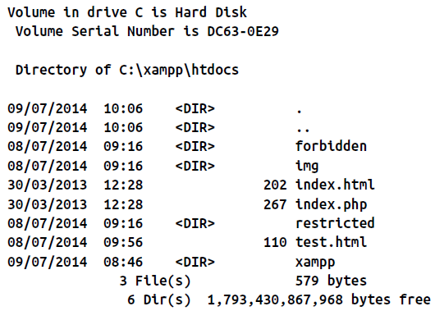
Depending on the system you are using, the result of running this program will look something like this (from a Windows dir command):

Slide 73
System Calls
1 2 3
exec takes three arguments: exec(escapeshellcmd($cmd), $output, $status);
The command itself (in the previous case, $cmd)
An array in which the system will put the output from the command (in the previous case, $output)
A variable to contain the returned status of the call (which, in the previous case, is $status)
If you wish, you can omit the $output and $status parameters, but you will not know the output created by the call or even whether it completed successfully.

Slide 74
System Calls
exec(escapeshellcmd($cmd), $output, $status);
You should also note the use of the escapeshellcmd function.
It is a good habit to always use this when issuing an exec call, because it sanitizes the command string, preventing the execution of arbitrary commands, should you supply user input to the call.

Slide 75
System Calls
TIP: The system calling functions are typically disabled on shared web hosts, as they pose a security risk.
You should always try to solve your problems within PHP if you can, and go to the system directly only if it is really necessary.
Also, going to the system is relatively slow, and you need to code two implementations if your application is expected to run on both Windows and Linux/Unix systems.

